Slide 1
“Temperature based Automatic Fan Speed Control System”
SECOND YEAR- ELECTRICAL ENGINEERING
MINI PROJECT

Slide 2
GROUP NO. 6
AMRIT TRIPATHI – 510619060
MOITREESH SAHA – 510619030
RISHIDEO RAJ – 510619070
D ARAVIND - 510619074
MEMBER’S LIST

Slide 3
INTRODUCTION
The AIM of our mini project is to control the fan speed which is dependent and controlled by the surrounding temperature. It will also maintain a certain optimum level of speed for the user convenience. As the temperature of the device increases or decreases, the speed of fan increases or decreases respectively.

Slide 4
DESCRIPTION
The temperature based fan speed control system is an electronic circuit consisting of a microcontroller. The proposed system is designed to detect the temperature of the room and send that information to the microcontroller board.Then it works on the contrast of current temperature and set temperature based on the programming .
The outcome obtained from the operation is given through the o/p port of an adruino board to the LCD display of related data.The generated pulses from the board which is further fed to the driver circuit to get the preferred output to the fan.

Slide 5
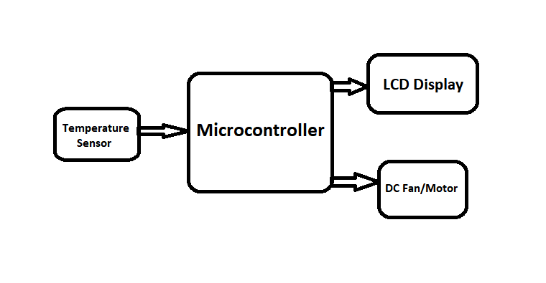
BLOCK DIAGRAM

Slide 6
HARDWARE COMPONENTS
Microcontroller 1 Arduino Uno R3
Temperature sensor 1 LM 35
LCD Display 1 16*2
Breadboard 1 Mini
N channel Mosfet 1 IRFZ44N
Resistor 3 1KΩ
Resistor 1 10KΩ
Diode 1 1N4007
Potentiometer 1 10KΩ
DC Fan 1 12V-24V, 2.6A, 7K RPM
DC Supply/ Battery 1 12V DC, 1-3A
Capacitor 1 10-⁵ F
LED 1 Red
Arduino IDE
Online Circuit Designer
C/C++ compilers and programming
Proteus ISIS Simulator 8.1
SOFTWARES

Slide 7
THE FINAL PROJECT BUDGET:
COMPONENTS | UNIT | UNIT RATE | COST
Arduino Uno (R3) | 1 | Rs 621 | Rs 621
16x2 LCD display | 1 | Rs 227 | Rs 227
LM35 Temperature Sensor | 1 | Rs 250 | Rs 250
Breadboard + Jumper wires | 1 | Rs 222 | Rs 222
Resistor (10kΩ) | 1 | Rs 1.21 | Rs 1.21
Resistor (1kΩ) | 3 | Rs 1.13 | Rs 3.39
Potentiometer (10kΩ) | 1 | Rs 34.5 | Rs 34.5
N-channel Mosfet (IRFZ44N) | 1 | Rs25 | Rs25
DC Motor (12V-24V, 2.6A, 7K RPM) | 1 | Rs 299 | Rs 299
Diode (1N4007) | 1 | Rs 4 | Rs 4
Capacitor (10µF) | 1 | Rs 4 | Rs 4
Rechargeable battery (12V DC, 1-3A) | 1 | Rs 1890 | Rs 1890
TOTAL PRICE |  |  | Rs 3581.1

Slide 8
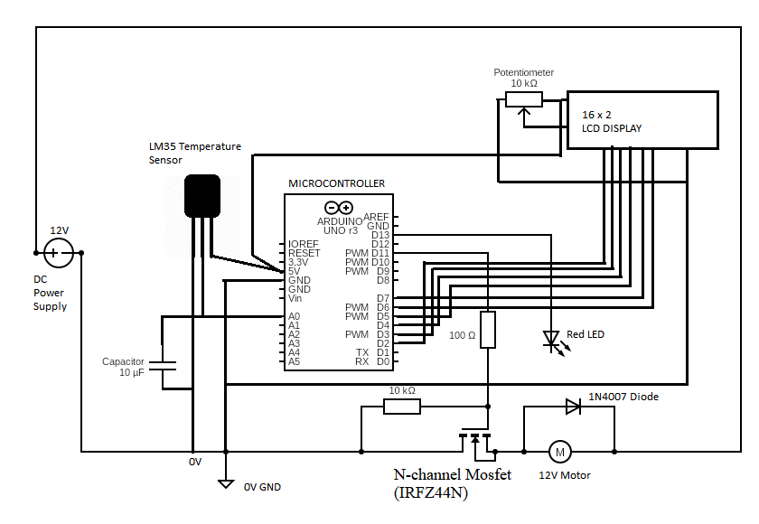
CIRCUIT DIAGRAM

Slide 9
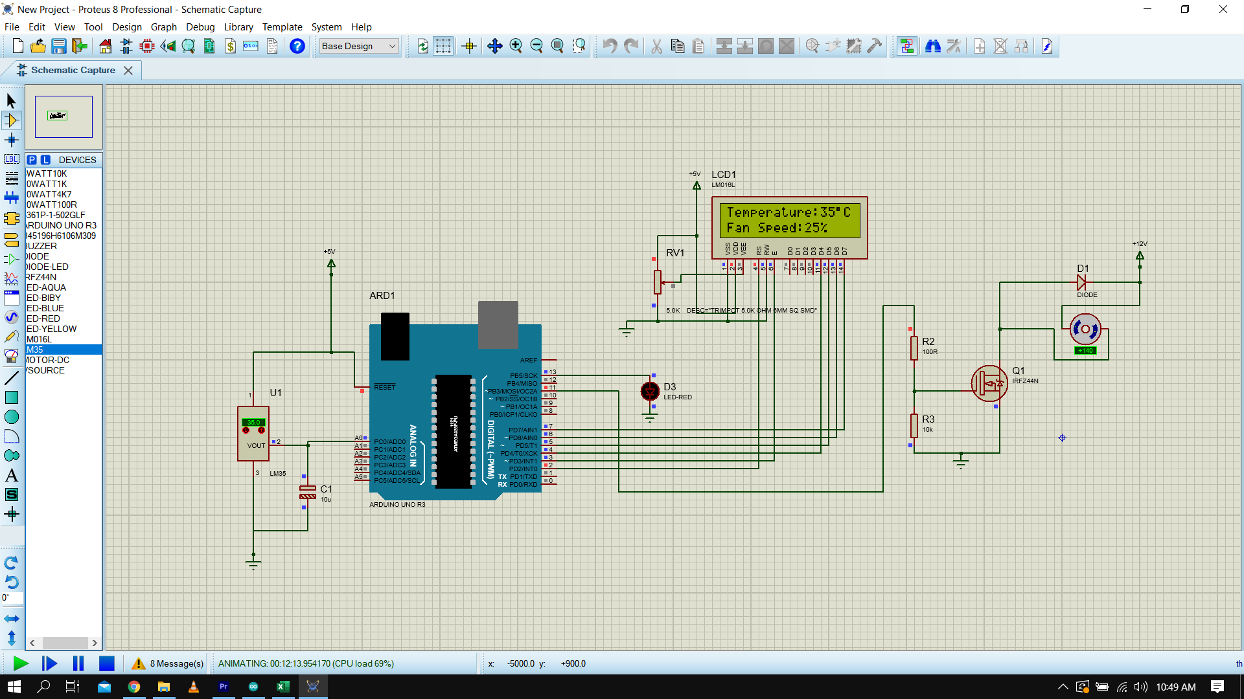

Slide 10
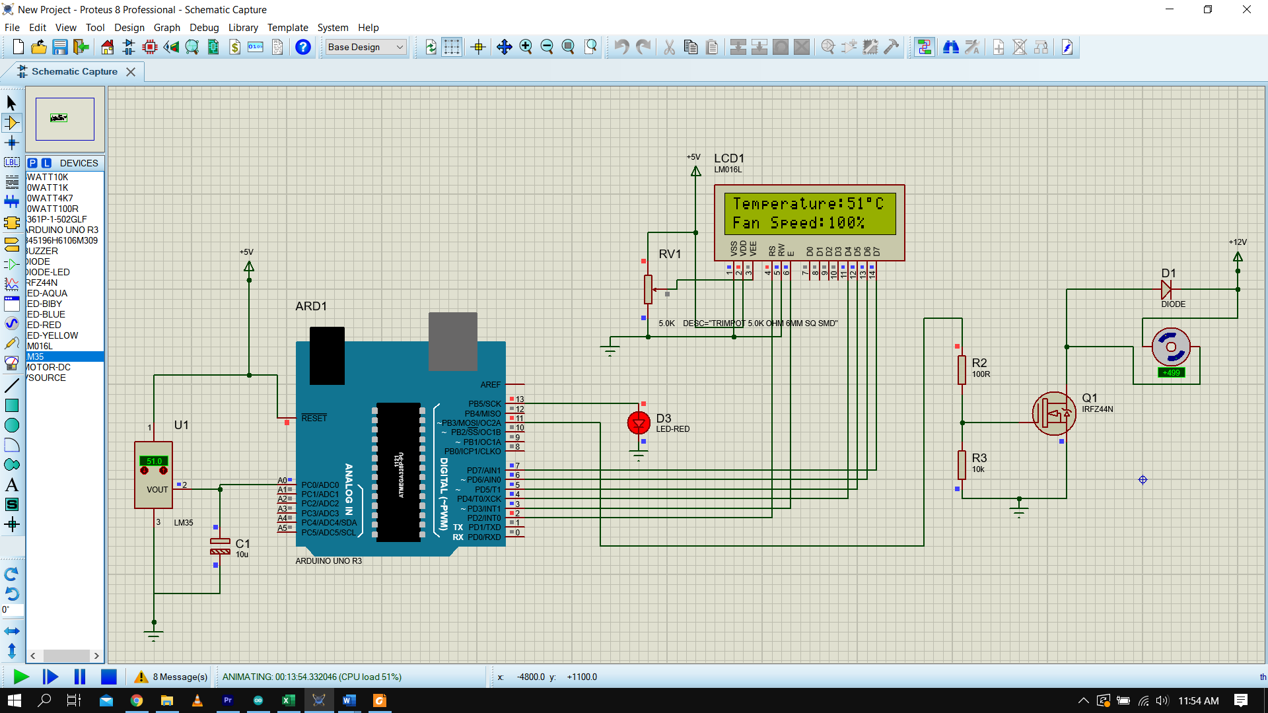

Slide 11
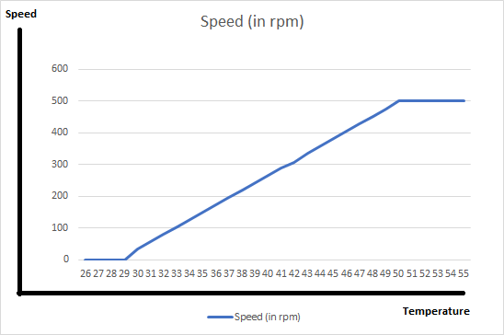
GRAPH PLOT (Speed Vs Temperature)

Slide 12
CONCLUSION
Thus, we got to know about the project and the components used in it. How the circuit is designed, how the microcontroller can be programmed and where these different components can be attached in the microcontroller. We have seen fans in our daily lives that runs when the current is supplied to the motor, but by this way, the fan’s speed can be manipulated by the surrounding temperature.
In this process, we also came to know about the temperature sensor. Hence this reduces man power required and makes the system smoother and more automatic.

Slide 13
ADVANTAGES
This project can be used in Home appliances as well as Industries easily.
This will help in managing the energy / electricity and sabing human effort.
To monitor the environments that is not comfortable, or possible, for humans to monitor, especially for extended periods of time.
FUTURE SCOPE
It can only be maintained by technical person. Thus, it becomes difficult to be maintained
Due to temperature variation, after sometimes its efficiency may decrease.
DISADVANTAGES
We can monitor more parameters like humidity, light and at the same time control them.
We can send this data to a remote location using mobile or internet to make it easier to monitor the changes when required.

Slide 14
BIBLIOGRAPHY
REFERENCES:
https://www.arduino.cc/en/Tutorial/HomePage
https://www.electronicwings.com/components/lm35-temperature-sensor#:~:text=LM35%20is%20a%20temperature%20measuring,is%2010%20mV%2Fdegree%20Celsius
https://components101.com/microcontrollers/arduino-uno
https://circuitglobe.com/npn-transistor.html
https://www.electrical4u.com/diode-working-principle-and-types-of-diode/#:~:text=A%20diode%20is%20defined%20as,resistance%20in%20the%20reverse%20direction
https://en.m.wikipedia.org/wiki/DC_motor
https://en.m.wikipedia.org/wiki/Breadboard
https://components101.com/16x2-lcd-pinout-datasheet

Slide 15
ACKNOWLEDGEMENT
It is a great privilege for us to express our profound gratitude to our project guide, respected Prof. Amal Barman, Electrical Engineering, IIEST, Shibpur for his constant guidance, valuable suggestions and supervision without which it would have been difficult to complete the work within scheduled time.
We would like to express our gratitude towards Prof. Prasid Syam and Prof. Kaushik Mukherjee for their kind guidance and encouragement which helped us in completion of this project.
We are thankful to the Department of Electrical Engineering gave us a chance to make a project in the process of which we learnt many new concepts.
THANK YOU

